Slide 1

ReinforceMENT LEARNING
RL METHODS AND ALGHORITMS

Slide 2
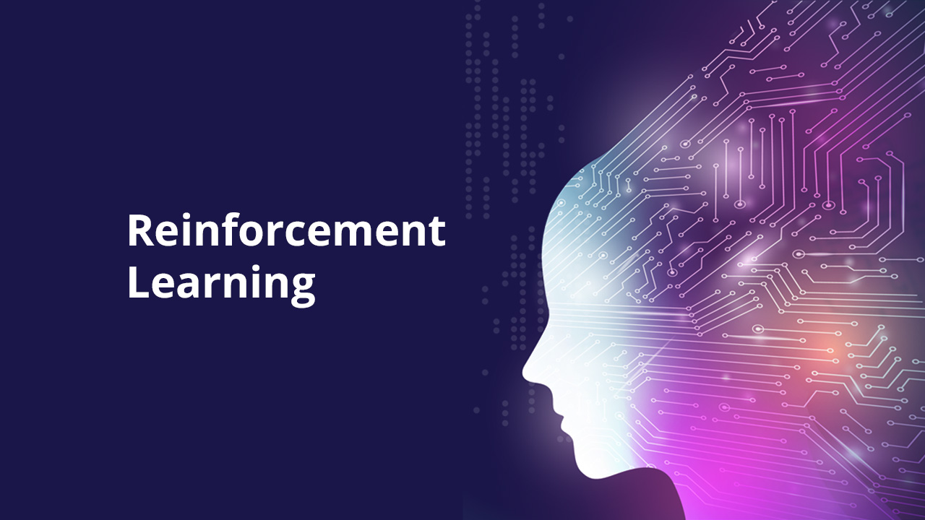
Objectives
DQN (Dueling, prioritized, double)
A2C
PPO

Slide 3
PONG

Slide 4
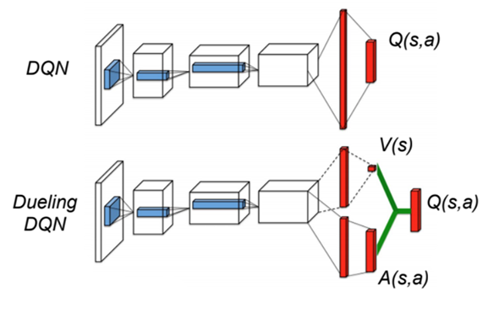
DQN Dueling

Slide 5
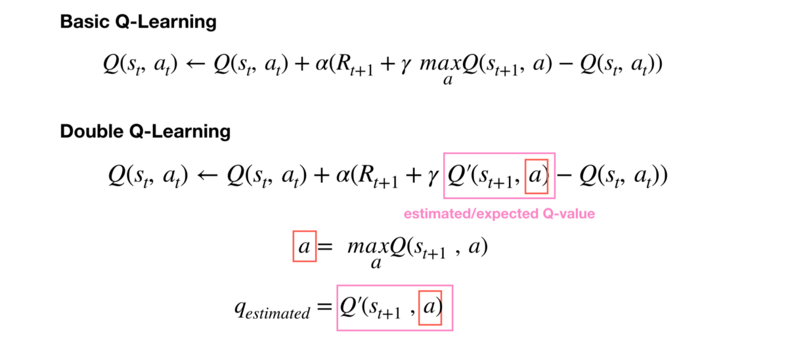
DQN Double

Slide 6
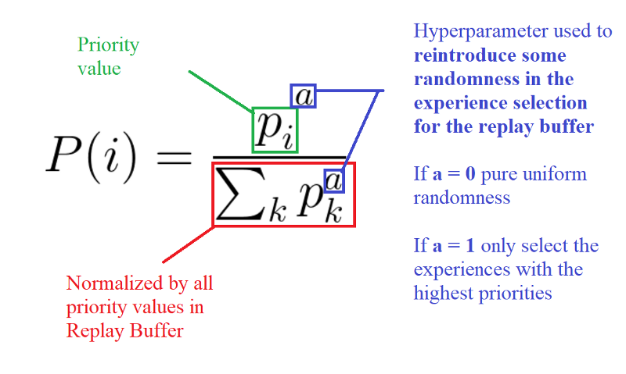
DQN prioritized experience replay

Slide 7
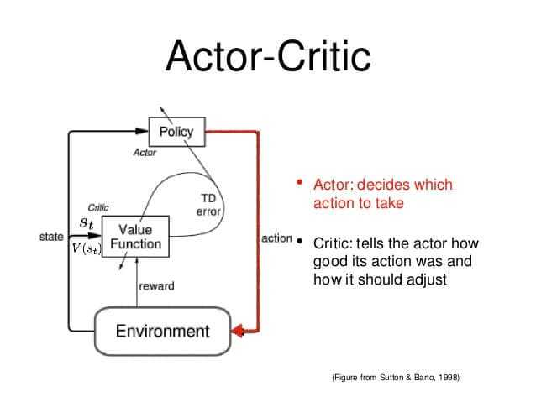
A2C

Slide 8
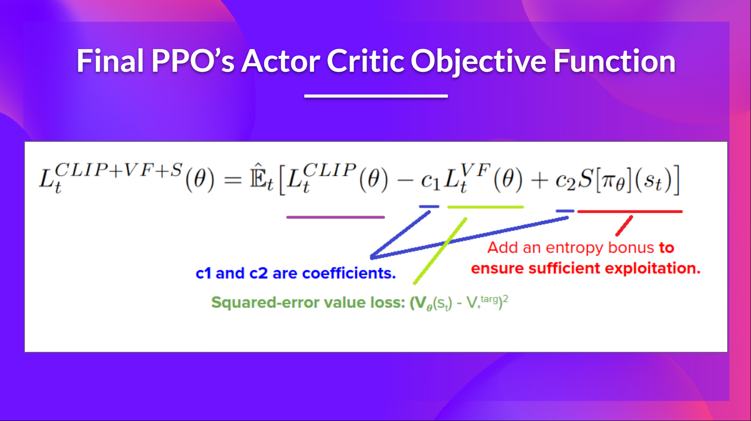
ppo

Slide 9
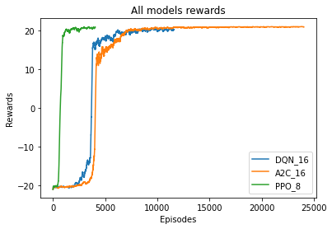
Final results

Slide 10

Thank you

